Slide 1


Slide 2
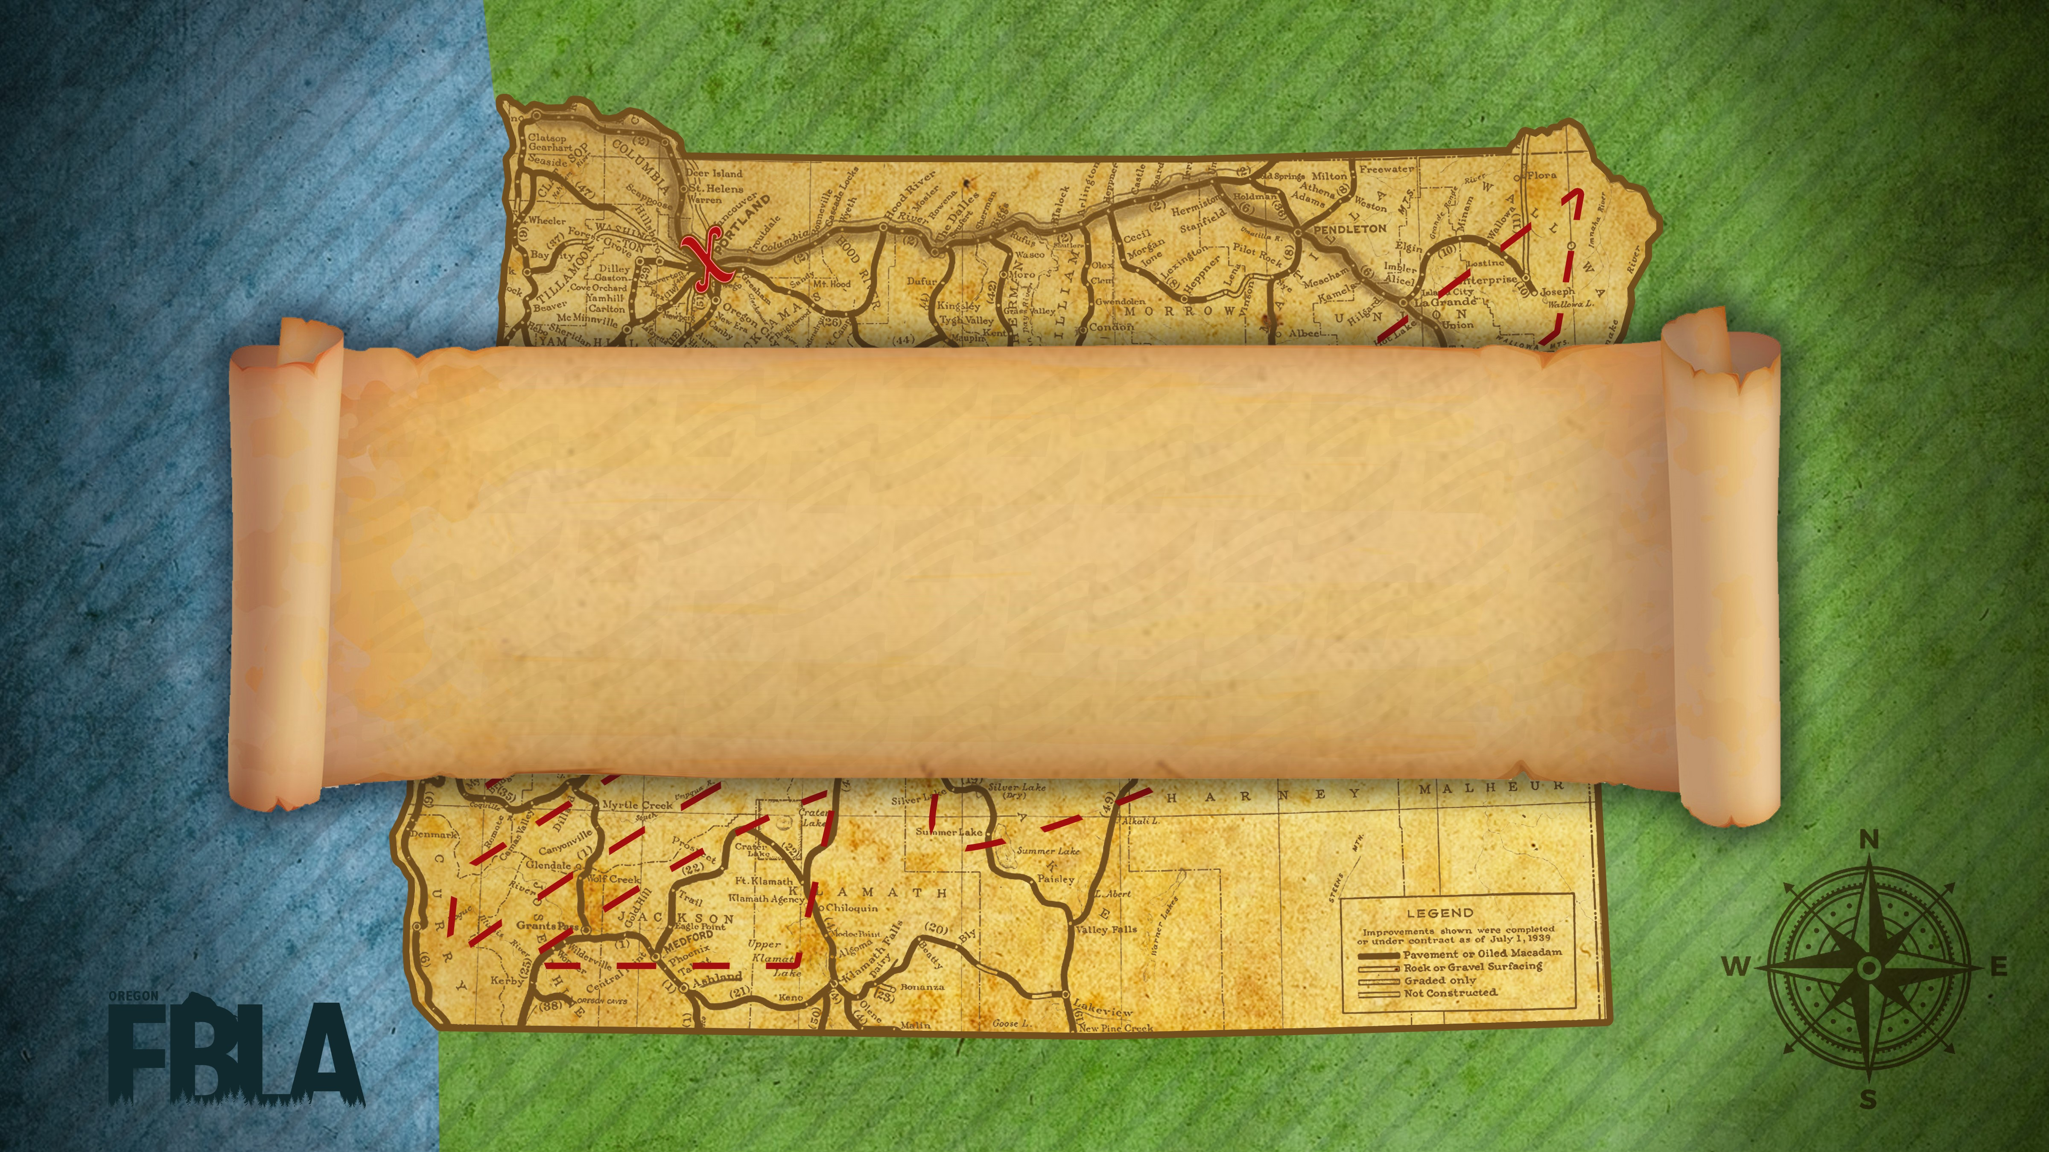
Awards Session 2

Slide 3
3D Animation
2nd Fukuda, Granillo
  Seaside Union High School
1st Cannon, Olson
  Seaside Union High School

Slide 4
Accounting 1
10th Sofia Villarreal
  North Marion High School
9th Erica Rodriguez Ortiz
  North Marion High School
8th Aiyana Brown
  Roseburg Senior High School
7th Austin Ueeck
  Silverton High School
6th Joseph Garcia
  Roseburg Senior High School
5th James Favot
  Tigard High School
4th Abi Dummer
  Silverton High School
3rd Tyler Marston
  Centennial High School
2nd Patrick Covlin
  Mountain View High School
1st Thomas McCall
  Silverton High School

Slide 5
Accounting II
10th Naarai Gomez
  Canby High School
9th Spencer Nelson
  Tigard High School
8th Diego Arredondo
  Canby High School
7th Samantha Floyd
  Grant Union High School
6th Alyssa Buckler
  Tualatin High School
5th Keaton Redding
  Tualatin High School
4th Ethan Dibble
  Tualatin High School
3rd Geoffrey Mahmud
  Tualatin High School
2nd Jacob Fitzpatrick
  Tualatin High School
1st Tyler Emerson
  Tigard High School

Slide 6
Advertising
10th Ethan Dibble
  Tualatin High School
9th Cynthia Lor
  McKay High School
8th Abigail Medak
  Roseburg Senior High School
7th Kathleen McVicker
  Tualatin High School
6th Ashley Kelley
  Gilchrist High School
5th Viviana Diaz
  McKay High School
4th Sophie Gratchner
  Tualatin High School
3rd Emma Ulven
  Canby High School
2nd Kirsten Olp
  North Douglas High School
1st Sarah Hall
  Tualatin High School

Slide 7
Agribusiness
10th Braden Jentzsch
  North Douglas High School
9th Luke Andersen
  Vale High School
8th Alley Guerin
  Pacific High School
7th Kenna Bernardin
  Mazama High School
6th Logan Gant
  North Douglas High School
5th Cami VanArsdale
  Heppner High School
4th Logan Waldron
  Wallowa High School
3rd Abi Dummer
  Silverton High School
2nd Austin Romans
  Nyssa High School
1st Austin Van Houten
  Oakland High School

Slide 8
Banking and Financial
7th Ostovar
  Stayton High School
6th Archer, Williams
  Scappoose High School
5th Petreaca, Watson
  West Salem High School
4th Delaney
  Lincoln High School
3rd Carlesen, Davis, Earll
  North Salem High School
2nd Alvarez, Barocio Garibay, Nguyen
  McKay High School
1st Lieuallen
  Tigard High School

Slide 9
Business Calculations
10th Neesa Nelson
  Pacific High School
9th Nick Ambrose
  Mazama High School
8th Michael Laun
  Neah - Kah - Nie High School
7th Rylee Mann
  Helix High School
6th Keora O'Meara
  Scappoose High School
5th Alyssa Buckler
  Tualatin High School
4th Eli Sprenger
  Helix High School
3rd Geoffrey Mahmud
  Tualatin High School
2nd Justin Pham
  Tualatin High School
1st April Hsu
  Lincoln High School

Slide 10
Business Communication
10th Kara Rumage
  Neah - Kah - Nie High School
9th Tara Keepers
  Creswell High School
8th Erica Rodriguez Ortiz
  North Marion High School
7th Macy Gage
  Neah - Kah - Nie High School
6th Karissa Hadermann
  Neah - Kah - Nie High School
5th Taya Riley
  Baker Senior High School
4th Animesh Patel
  Neah - Kah - Nie High School
3rd Lillian Rinkle
  Oakland High School
2nd Yasmine Cida Guzman
  North Marion High School
1st Hayley Braack
  Oakland High School

Slide 11
Business Etiquette
10th Alexandria Coleman
  Coffenberry Middle Level
9th Karissa Frahm
  Joseph Lane Middle School
8th Sydnie Brandon
  Grant Union High School
7th Gracie Howell
  Imbler Middle Level
6th Alicie Archibald
  Grant Union High School
5th Audrey Hamilton
  Molalla Middle School
4th Shaeli Sikes
  Joseph Lane Middle School
3rd Dakota Wilson
  Gilchrist Middle Level
2nd Abbie Justice
  Grant Union High School
1st William Carpenter
  Coffenberry Middle Level

Slide 12
Business Law
10th Brandy Shaddy
  Nyssa High School
9th Stephania Mariscal
  North Marion High School
8th Macy Thomas
  McLoughlin High School
7th Wyatt Mayhugh
  Seaside Union High School
6th Caden Morthland
  Tualatin High School
5th Lucy Theiler
  La Grande High School
4th Karinna Leonard
  Creswell High School
3rd Madison Eckhart
  Imbler High School
2nd Taya Riley
  Baker Senior High School
1st Samuel Hofer
  Tigard High School

Slide 13
Business Math and Financial Literacy
10th Keaton Pennington
  New Hope Christian Schools ML
9th Christine McCoy
  Coffenberry Middle Level
8th Jeremiah Martin
  Imbler Middle Level
7th Aiden Fiske
  New Hope Christian Schools ML
6th Timothy Haley
  New Hope Christian Schools ML
5th Riley Yunker
  New Hope Christian Schools ML
4th Treyton Sams
  Wallowa Middle Level
3rd Elias Malak
  Joseph Lane Middle School
2nd Daniel Grim
  New Hope Christian Schools ML
1st Shaeli Sikes
  Joseph Lane Middle School

Slide 14
Next Session
ML Career Exploration
Computer Problem Solving
Cyber Security
Digital Video Production
Economics
Entrepreneurship
ML Ethical Leadership
Future Business Leader
Global Business

