Slide 1


Slide 2
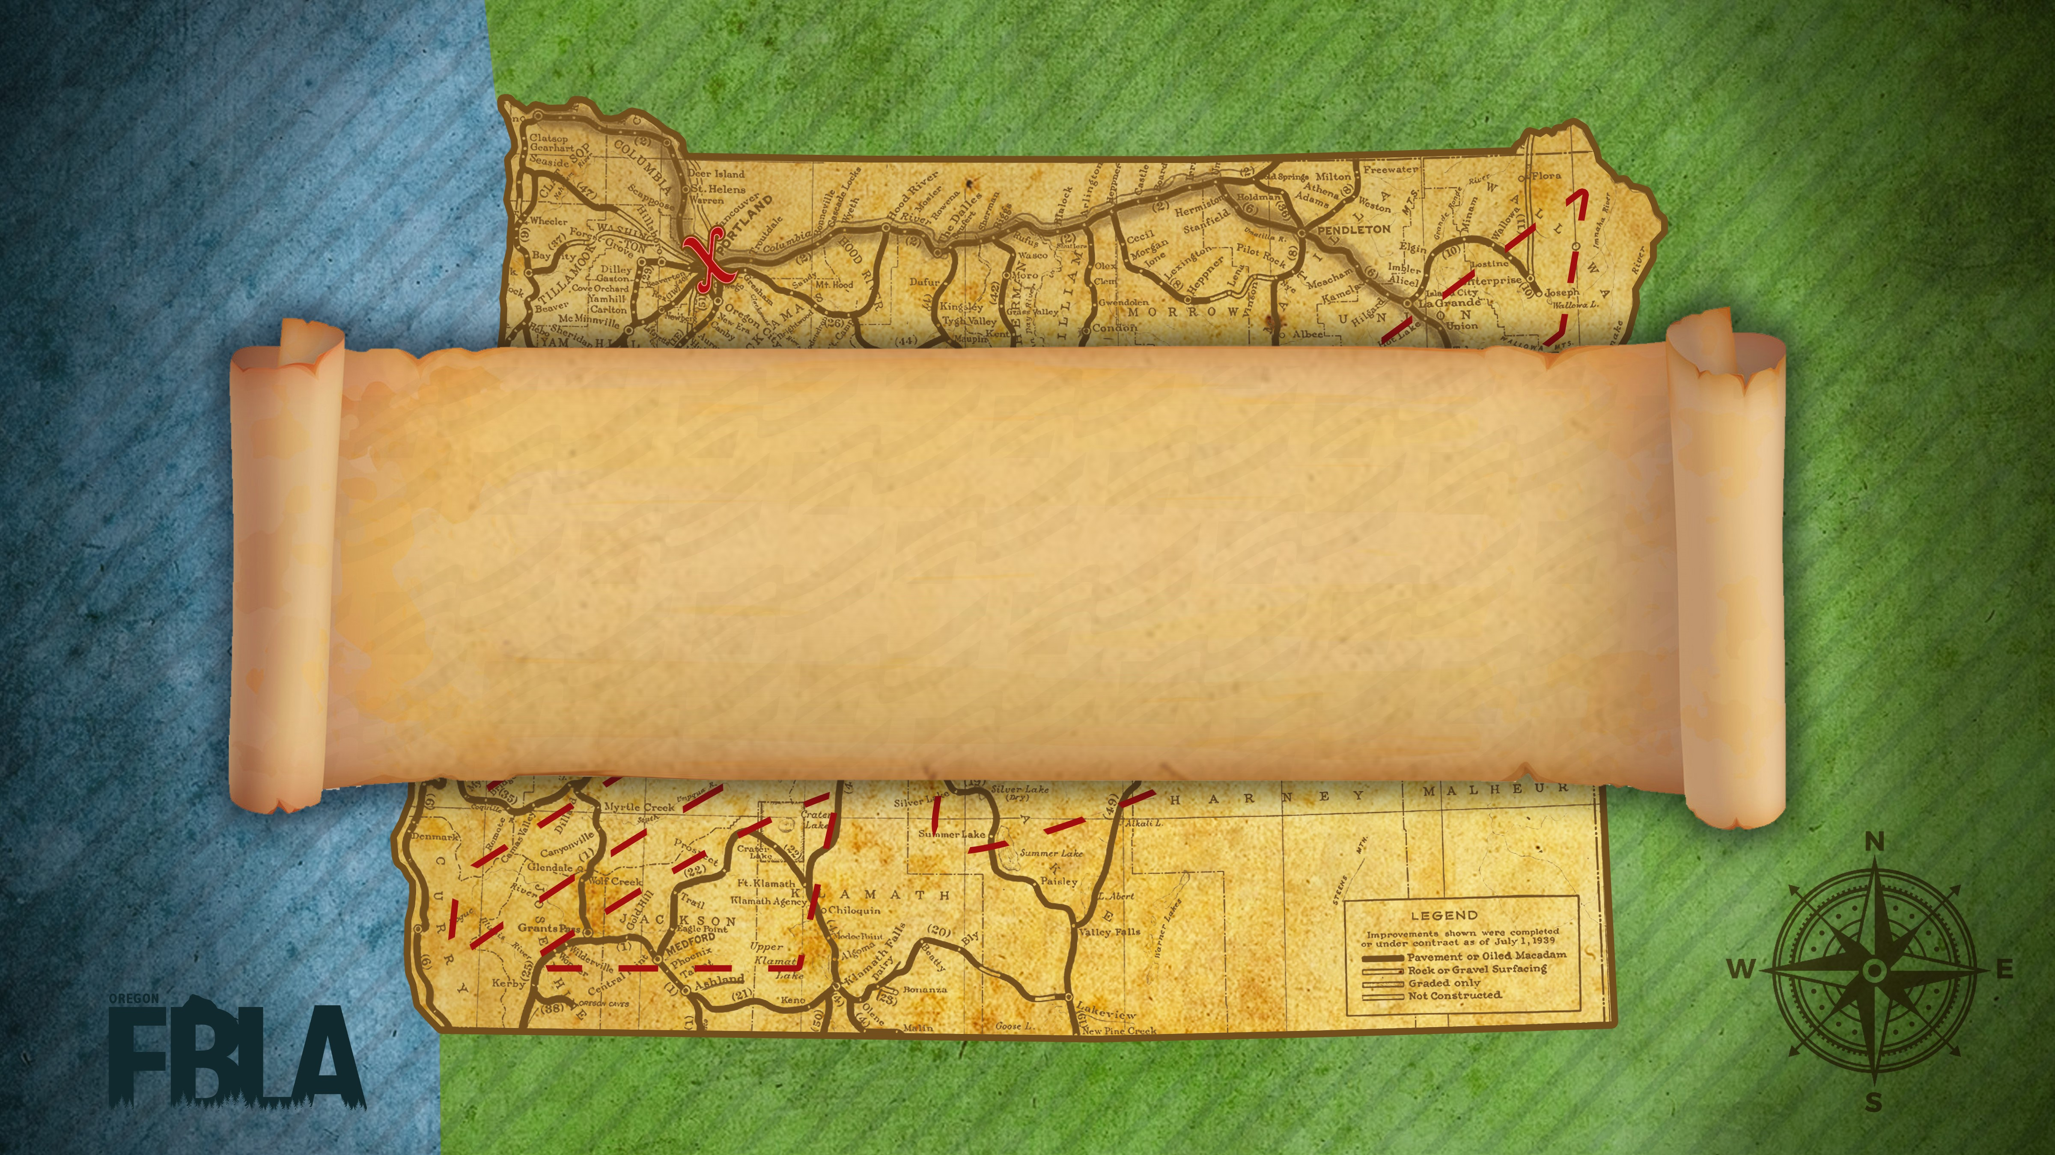
Award Session 3

Slide 3
Career Exploration
10th Mary-Anne Joles
  Baker Middle School
9th Alexandria Coleman
  Coffenberry Middle Level
8th Karissa Frahm
  Joseph Lane Middle School
7th Tayler Bowles
  Imbler Middle Level
6th Peytton Miller
  Imbler Middle Level
5th Victoria Ellis
  New Hope Christian Schools ML
4th Izabel Martin
  Imbler Middle Level
3rd Colten Strohmeyer
  Molalla Middle School
2nd Amadeus Hernandez
  Lost River Jr/Sr ML
1st Jessica Journigan
  Wallowa Middle Level

Slide 4
Computer Problem Solving
10th Jesus Mora
  Dayton High School
9th Hanna Sam
  Tigard High School
8th John Cochell
  McLoughlin High School
7th Isabella Mon
  North Marion High School
6th Nikolas Patterson
  Pacific High School
5th Ethan Cooke
  Tigard High School
4th Jake Smith
  Tigard High School
3rd Sam D'Hondt
  Tigard High School
2nd CJ Parker
  Tigard High School
1st Mitchell Atwood
  Tigard High School

Slide 5
Cyber Security
10th Alley Guerin
  Pacific High School
9th Layn Schefter
  Tigard High School
8th Jacob Webb
  Elgin High School
7th Mason Fast
  Tigard High School
6th Bryan Viveros Tapia
  Tigard High School
5th Marcus Voytko-McLaughlin
  Tigard High School
4th Damian Amerman-Smith
  Pacific High School
3rd Kimberly Yeo
  Tigard High School
2nd Jorge Mendieta
  Vale High School
1st John Atkins
  Lincoln High School

Slide 6
Digital Citizenship
10th Rylie Benton
  Gilchrist Middle Level
9th Faith Drennen
  Coffenberry Middle Level
8th Aniya Spurlock
  Gilchrist Middle Level
7th George Harders
  Coffenberry Middle Level
6th Justin Woody
  Coffenberry Middle Level
5th Angelica Navalta
  Coffenberry Middle Level
4th Jadyn Tanzey
  Wallowa Middle Level
3rd Dallin Rasmussen
  Imbler Middle Level
2nd Jazmin Cobian
  Lost River Jr/Sr ML
1st Braden Dawson
  Lost River Jr/Sr ML

Slide 7
Digital Video Production
6th Scruggs, Worley
  Parkrose High School
5th Daniels
  Baker Senior High School
4th Karnstein, White
  Lincoln High School
3rd Gauthier, Maheu
  McNary High School
2nd Calkins, Rosenbaum-Church
  Roseburg Senior High School
1st Nelson, Rapp
  Seaside Union High School

Slide 8
Economics
10th Morgan Flanagan
  Roseburg Senior High School
9th Ellie Cunnington
  Tualatin High School
8th Wil Powell
  Oakland High School
7th Keora O'Meara
  Scappoose High School
6th Kevin Bergh
  Tualatin High School
5th Angel Liu
  Lincoln High School
4th April Hsu
  Lincoln High School
3rd Samuel Hofer
  Tigard High School
2nd Justin Pham
  Tualatin High School
1st Kaylee Mo
  Tualatin High School

Slide 9
Entrepreneurship
10th Hayter, Moore
  Silverton High School
9th Ambrosini, Hill
  Roseburg Senior High School
8th Blanchard, Porter
  Tualatin High School
7th Watson
  West Salem High School
6th Long, Wise
  Baker Senior High School
5th Floyd, Robertson, Robertson
  Grant Union High School
4th Grubbs, Leach, Symmes
  Creswell High School
3rd Andersen, Mendieta, Ruckman
  Vale High School
2nd Krebs
  Tigard High School
1st Hall, Mo
  Tualatin High School

Slide 10
Future Business Leader
10th Christina Ivanov
  McNary High School
9th Sakkara Boata
  McNary High School
8th Stephanie Zacarias
  Lost River High School
7th Lizbeth Cazarez
  Lost River High School
6th Mckenna Olson
  McNary High School
5th Cody Gustafson
  Yoncalla High School
4th Nathan Hantzmon
  Mazama High School
3rd Kevin Rojas
  North Marion High School
2nd Cypress Barrett
  Molalla High School
1st Lola Mcilhenny
  Molalla High School

Slide 11
Global Business
10th Kenxo
  Vale High School
9th Naranjo-Cruz
  Dayton High School
8th Benz, Jones
  Ridgeview High School
7th Lund, Zawacki
  Tualatin High School
6th Krider, Vieyra Aguayo
  North Salem High School
5th Kelley
  Gilchrist High School
4th Ruiz Vasquez, Zamudiobucio
  North Salem High School
3rd Rutan, Way
  Roseburg Senior High School
2nd Gartrell, Wrenn
  Canby High School
1st Cochran, Rosenblad
  Centennial High School

Slide 12
Next Session
Help Desk
Hospitality Management
Insurance and Risk Management
Intro to Business
Intro to Business Communication
Intro Business Procedure
ML Intro to Computer Science and Coding
Intro to FBLA
Intro to Financial Math
Intro to Information Technology
Intro to Parliamentary Procedure

