Slide 1
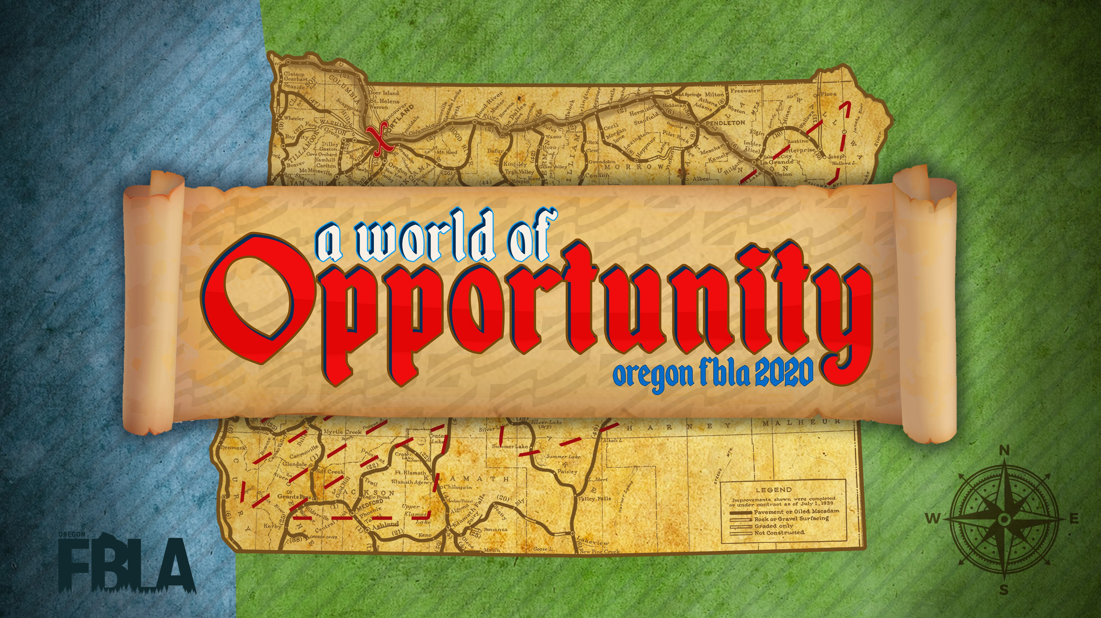

Slide 2
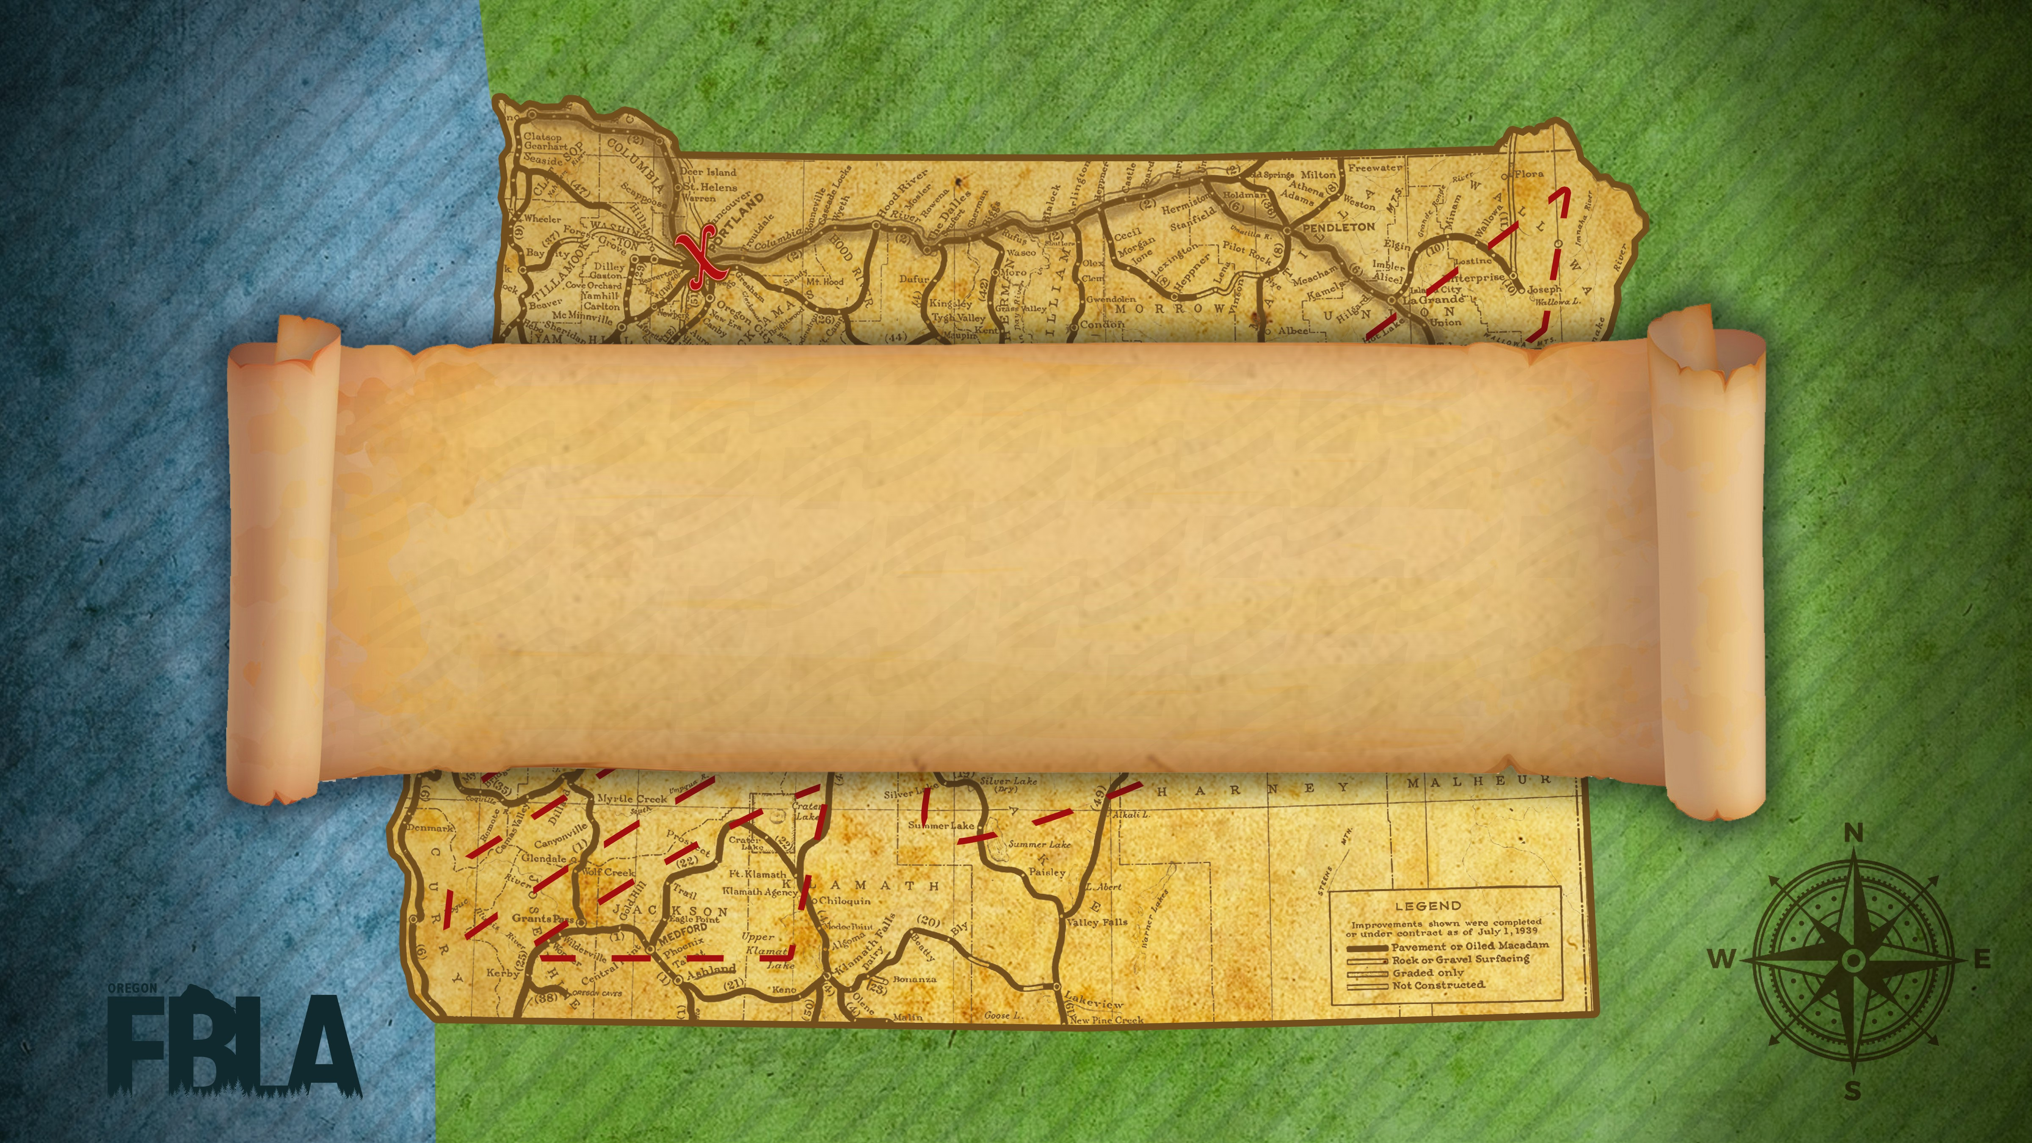
Awards Session 7

Slide 3
Elevator Speech
7th Olivia Roberts
  Coffenberry Middle Level
6th Samuel Haley
  New Hope Christian Schools ML
5th Colten Strohmeyer
  Molalla Middle School
4th Kale Bingaman
  Imbler Middle Level
3rd Henry Treat
  Imbler Middle Level
2nd Tayler Bowles
  Imbler Middle Level
1st Emmalyn Barnett
  New Hope Christian Schools ML

Slide 4
Spread the Word
1st Chavez Morfin, Ehleringer
  Molalla Middle School

Slide 5
The Interview
3rd Timothy Haley
  New Hope Christian Schools ML
2nd Jayda Cant
  Imbler Middle Level
1st Kale Bingaman
  Imbler Middle Level

Slide 6
The Tank

Slide 7
E-Business
6th Fierling
  Molalla High School
5th Patterson
  North Marion High School
4th Fraser, Kirby, Santiago
  Seaside Union High School
3rd Benson, Niehaus
  Baker Senior High School
2nd Patel
  Ridgeview High School
1st Martinez-Ordonez, Parker
  Centennial High School

Slide 8
Emerging Business Issues
6th Estabrooks
  Baker Senior High School
5th Rinkle, Yates
  Oakland High School
4th Burky, Hewitt
  Roseburg Senior High School
3rd Dela Cruz, Gouge
  Roseburg Senior High School
2nd Peterson, Sahr
  Hidden Valley High School
1st Bassett, Gomez
  Canby High School

Slide 9
Mobile Application Development

Slide 10
Public Service Announcement
5th Eufragio Morales, Eufragio Morales, Pritchard
  Molalla High School
4th Gilmore, Harper, Sandlin
  Mountain View High School
3rd Cordero, Lamar
  Hidden Valley High School
2nd Caballero, Patzer
  North Marion High School
1st Masse, Varner
  Seaside Union High School

Slide 11
Publication Design
1st Castro, Higdon, Wunderlich
  Seaside Union High School

Slide 12
Social Media Campaign
5th Crume, Yunker, Zumhofe
  New Hope Christian School
4th Treat, Whitmore
  Imbler High School
3rd Wise
  Baker Senior High School
2nd Gill, Jennings
  Lincoln High School
1st Hernandez, Quach
  North Salem High School

