Slide 1


Slide 2
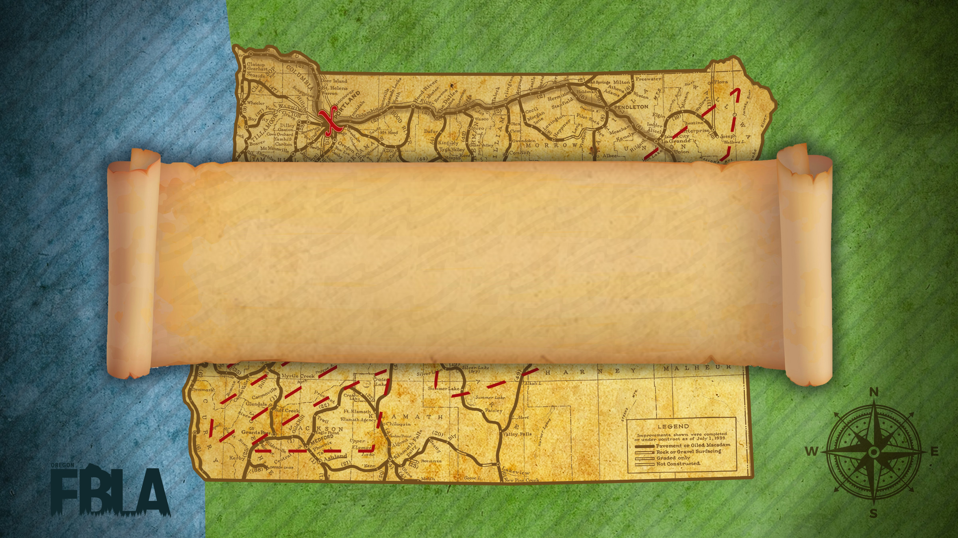
Award Session 1

Slide 3
American Enterprise Project
6th Mazama High School
5th Molalla High School
4th Elgin High School
3rd Hidden Valley High School
2nd Seaside Union High School
1st Imbler High School

Slide 4
Community Service Project
9th Elgin High School
8th Imbler High School
7th Hidden Valley High School
6th New Hope Christian School
5th Silverton High School
4th Mazama High School
3rd Parkrose High School
2nd Seaside Union High School
1st Roseburg Senior High School

Slide 5
Local Chapter Annual Business Report
9th Foss-Howard
  Molalla High School
8th Colwell, Smith
  Imbler High School
7th Arras, Williams
  Hidden Valley High School
6th Mills
  Baker Senior High School
5th Harvey, Palmer
  Elgin High School
4th Thompson, Vasquez
  North Salem High School
3rd Ambrosini, Killgore
  Roseburg Senior High School
2nd Cochran
  Centennial High School
1st Insko
  La Grande High School

Slide 6
Partnership with Business Project
3rd Elgin High School
2nd Seaside Union High School
1st Hidden Valley High School

Slide 7
Computer Applications
5th Christian Treat
  Imbler High School
4th Luke Sather
  Imbler High School
3rd Brendan Colwell
  Imbler High School
2nd Zaira Leon
  Vale High School
1st Brooklyn Konruff
  Neah - Kah - Nie High School

Slide 8
Database Design and Application
4th Jacob Waldron
  Neah - Kah - Nie High School
3rd Megan Troutman
  Neah - Kah - Nie High School
2nd Isabella Nemec
  Baker Senior High School
1st Caitlin Lien
  Baker Senior High School

Slide 9
Spreadsheet Applications
9th Logan Chesnut
  Neah - Kah - Nie High School
8th Sophie Geiger
  Neah - Kah - Nie High School
7th Olivia Hooley
  Neah - Kah - Nie High School
6th Tyler Spoon
  Mazama High School
5th Jacquelyn Ortiz
  Baker Senior High School
4th Kyla Harper
  Helix High School
3rd Abby Beck
  Mazama High School
2nd Sean Earll
  North Salem High School
1st Rhiannon Canary
  Scappoose High School

Slide 10
Word Processing
9th Brandon Liang
  Tigard High School
9th Rory Hill
  Union High School
8th Macy Clemens
  Mazama High School
7th Danika Brannon
  North Douglas High School
6th Jack Hunt
  Mazama High School
5th Tyler Spoon
  Mazama High School
4th Monica Villarreal
  North Marion High School
3rd Sydney Bolyard
  Vale High School
2nd Jimena Caballero
  North Marion High School
1st Macy Thomas
  McLoughlin High School

Slide 11
Business Financial Plan
3rd House
  Oakland High School
2nd Mayhugh, Rodriguez, Seppa
  Seaside Union High School
1st Garlinghouse, Hawker
  Silverton High School

Slide 12
Business Plan
8th Bell, Justice, Theiler
  La Grande High School
7th Ivanov
  McNary High School
6th Castleton-Rudolph, Martin, Salvador Lopez
  Molalla High School
5th Callaham, Devin
  Elgin High School
4th Hawker, Hupp, Johnston
  Silverton High School
3rd Bello, Flores
  Seaside Union High School
2nd Beachy, Cross
  Hidden Valley High School
1st Eck
  Bonanza High School

